Slide 1

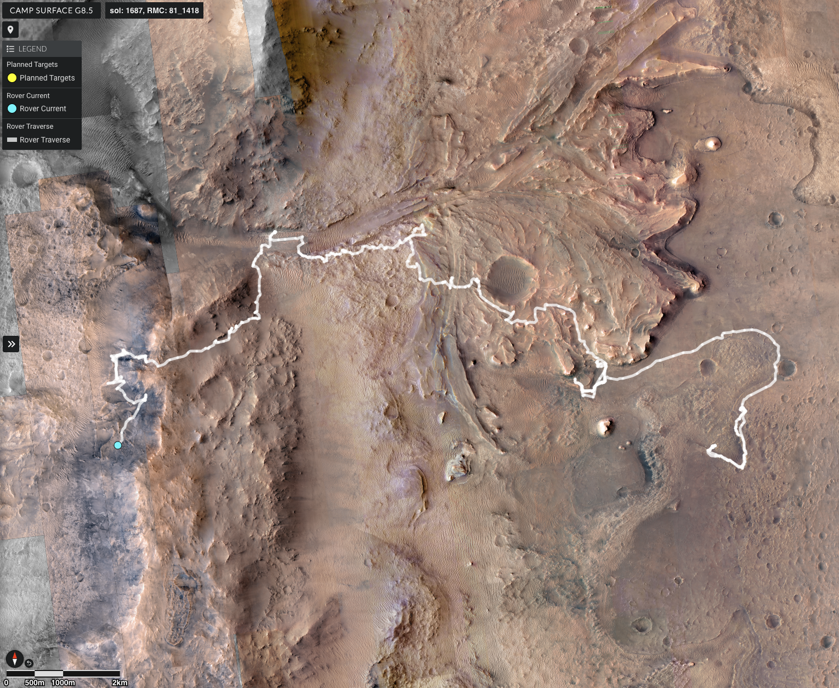
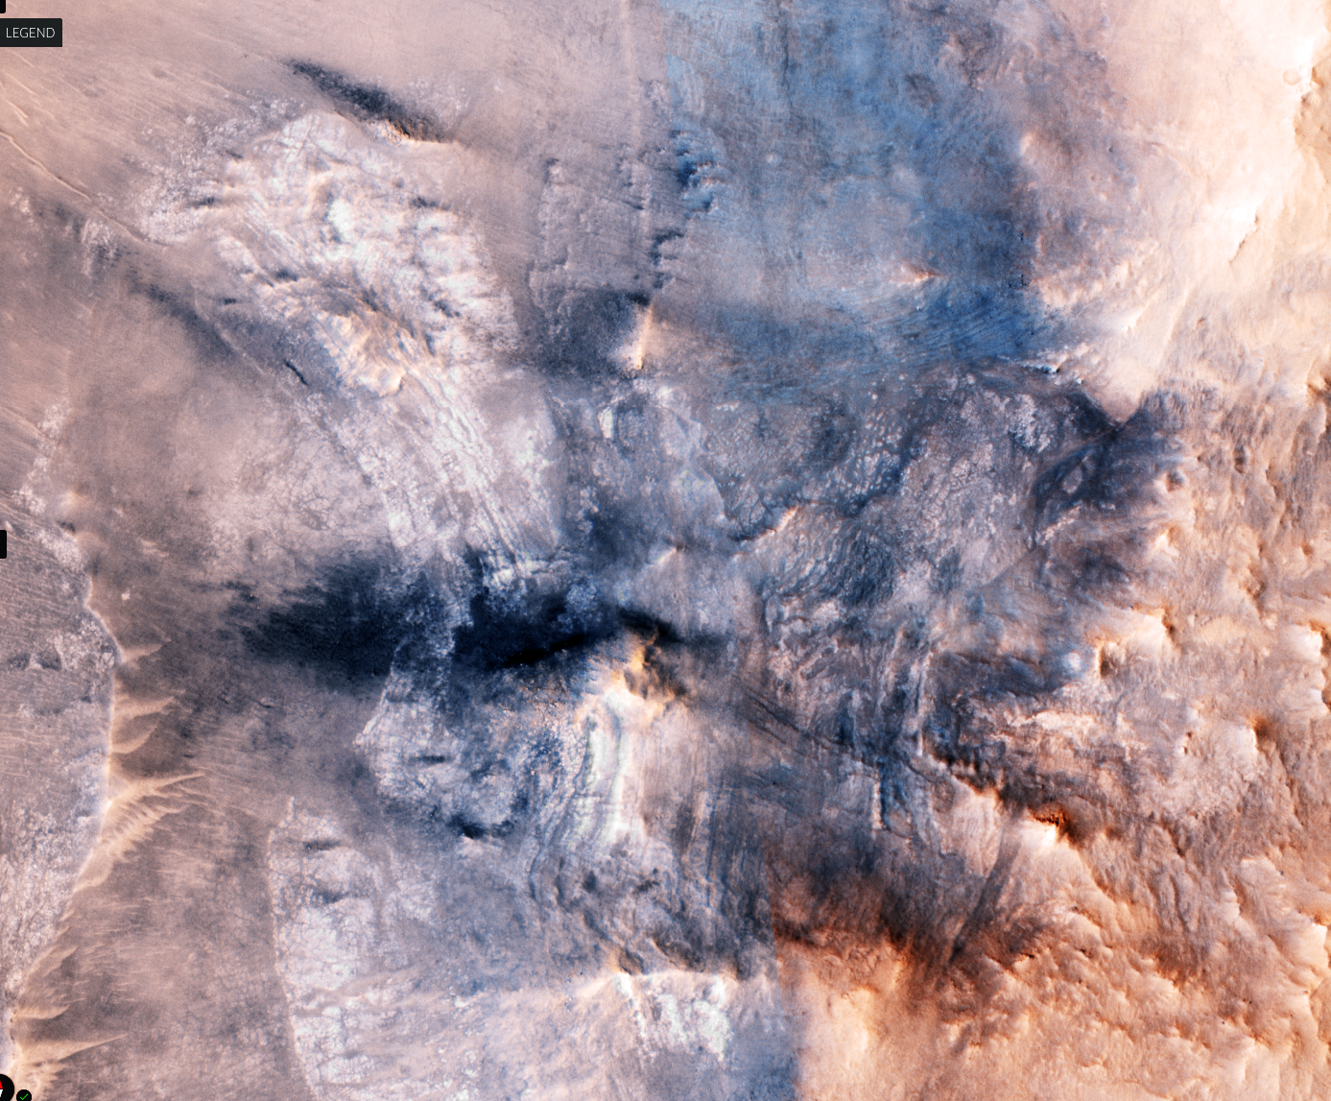
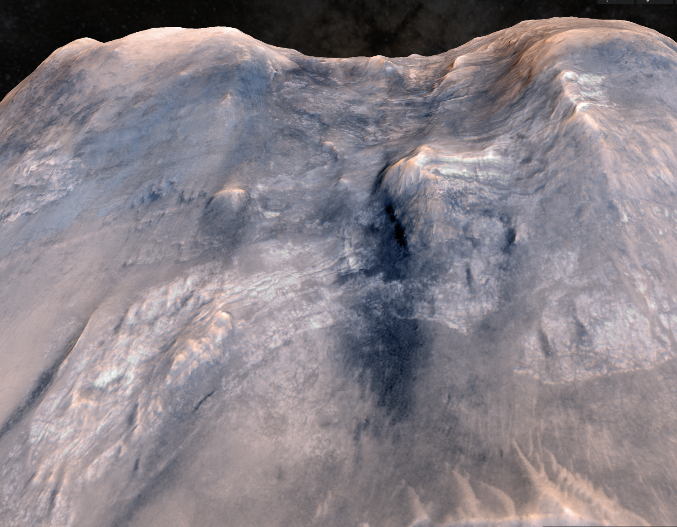
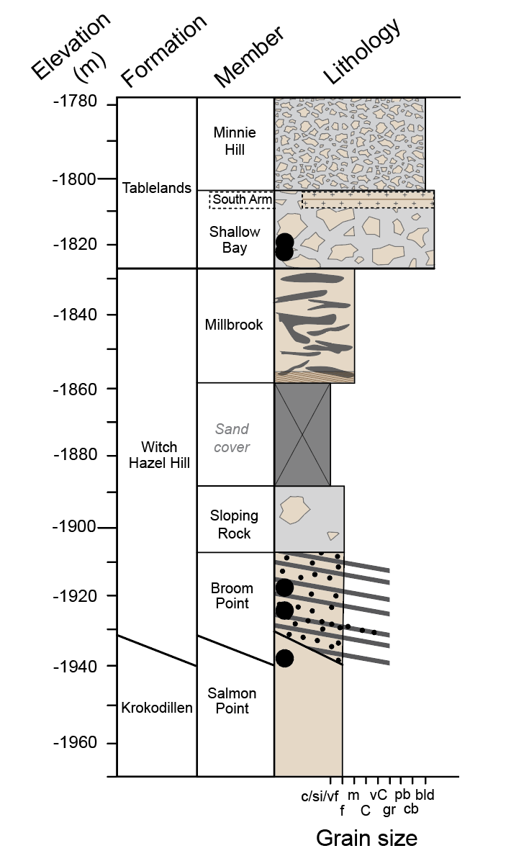
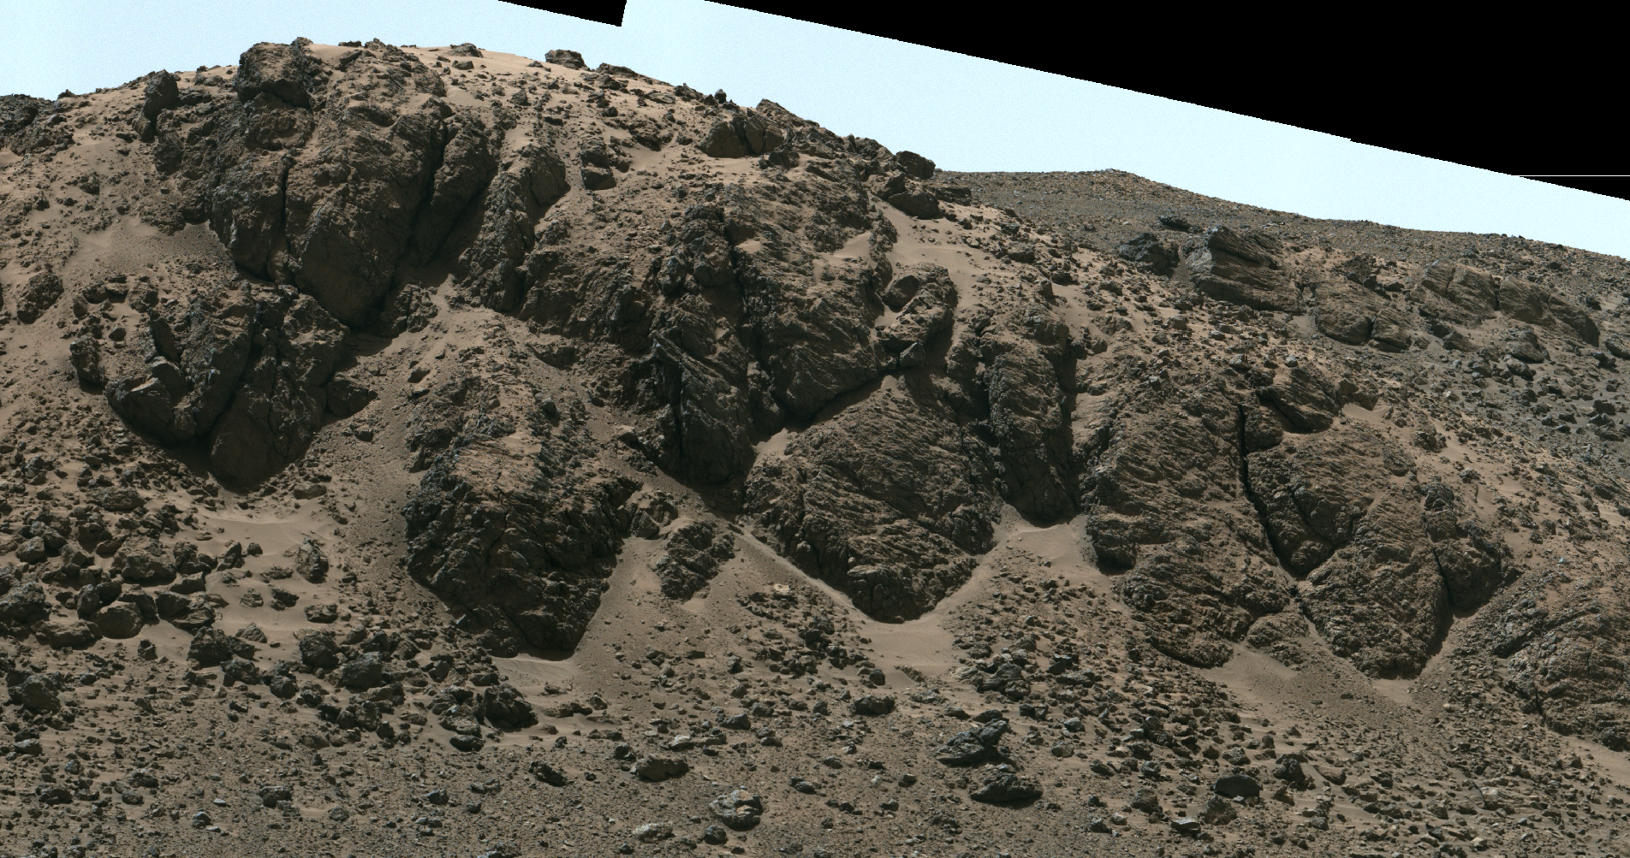
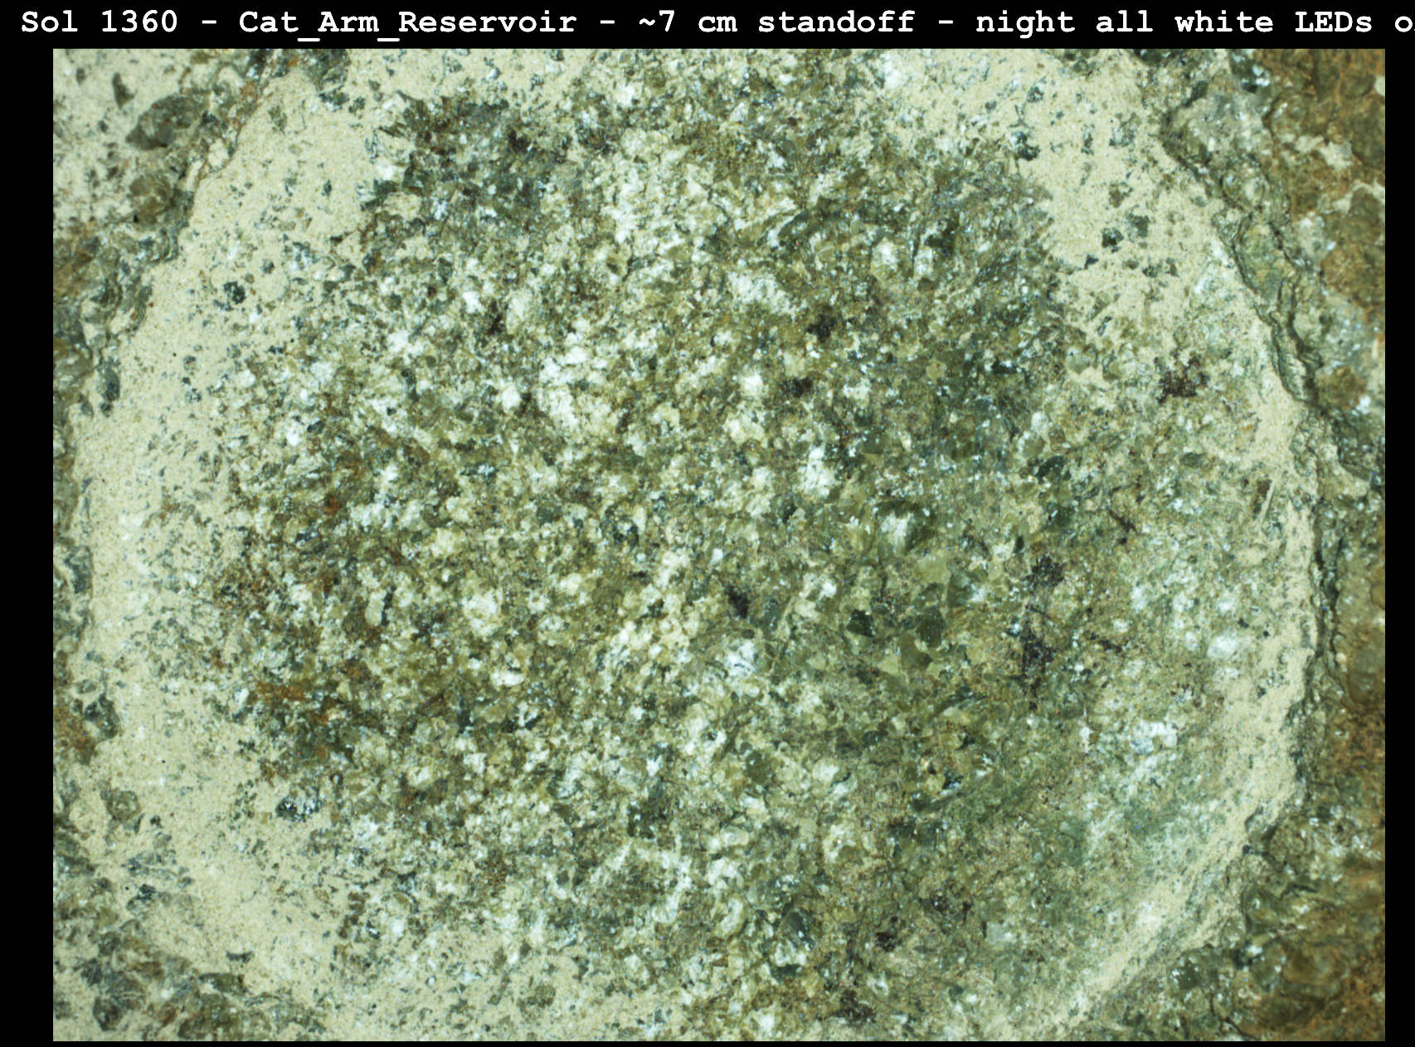
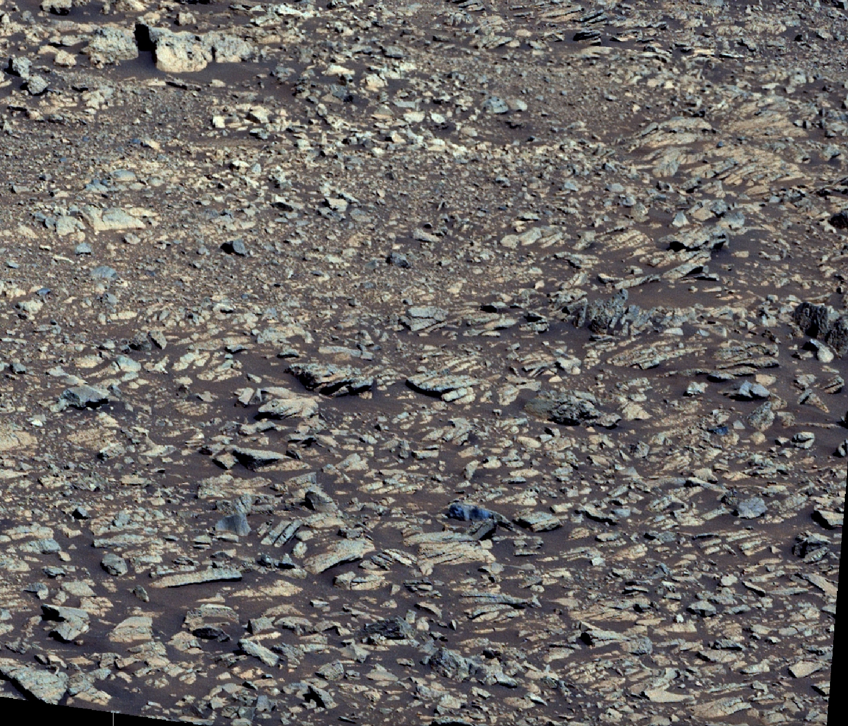
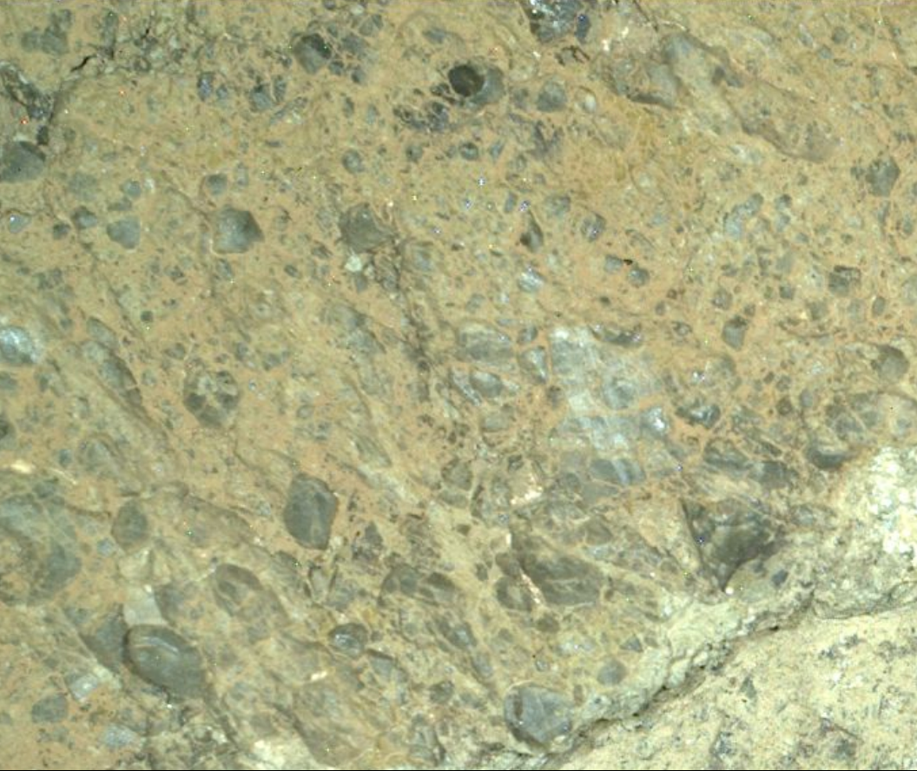
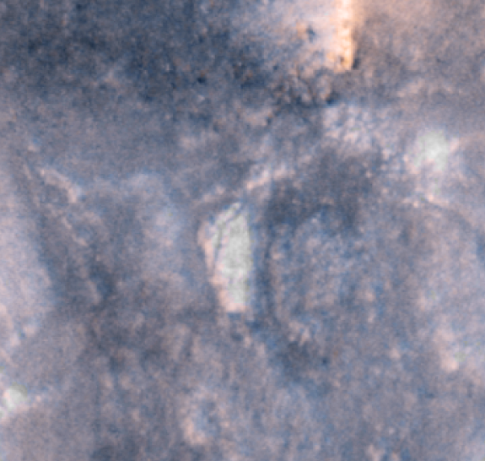
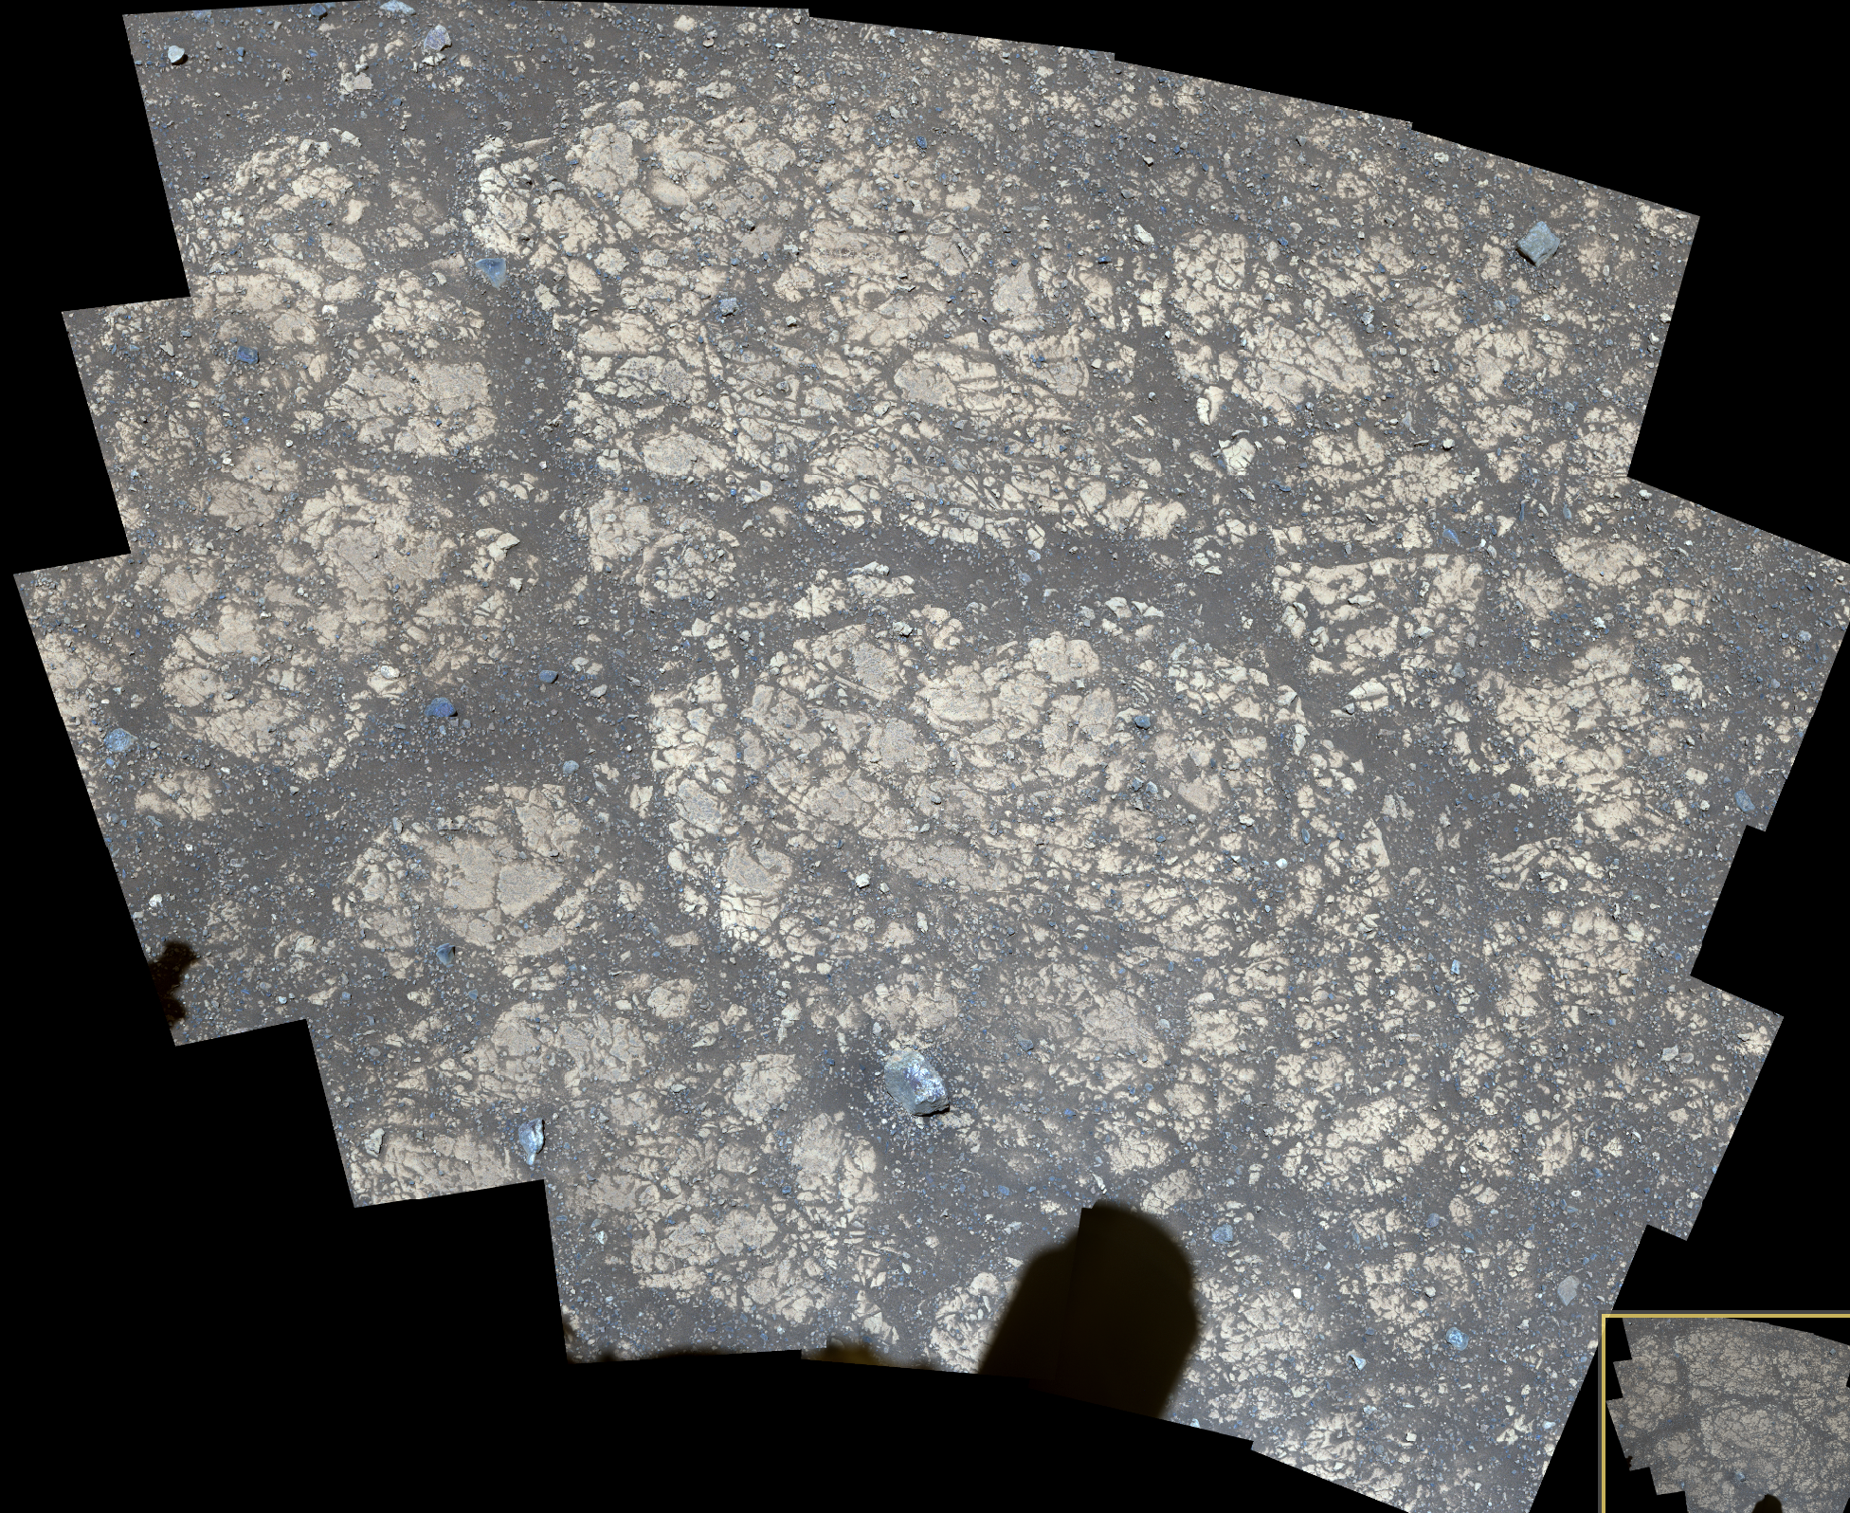
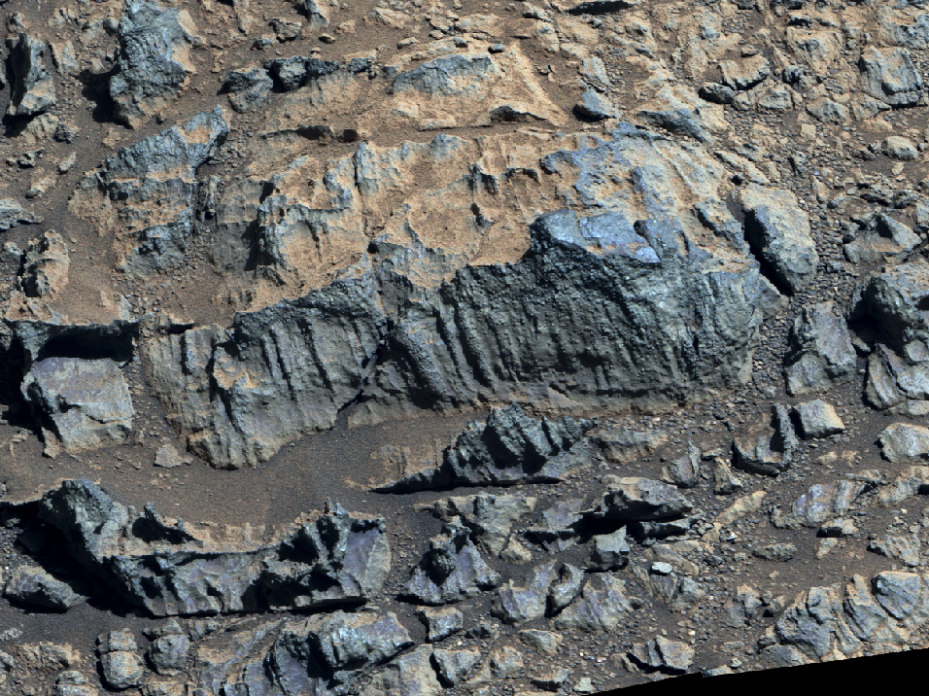
National Aeronautics and Space Administration
Postdoc Research
Stratigraphic synthesis of the Witch Hazel Hill region of the Jezero crater rim: classification of units and hypotheses for formation
Author: Samantha Gwizd, JPL postdoctoral fellow (322)
Katie Stack Morgan (322), Michael Bramble (322), Mars 2020 Science Team- Geologic Context Working Group
Background
The Jezero crater rim represents an opportunity to assess the structure, topography, and pre-Jezero (and Isidis) geology of a preserved complex crater rim in situ for only the second time on Mars. The Witch Hazel Hill (WHH) region, located on the western flank of the Jezero crater rim, was investigated with the Mars 2020 Perseverance rover as part of the Crater Rim Campaign [1] from Sol 1359 through ~Sol 1556 (Fig. 1 & 2). The 200 m thick succession of rocks comprising the WHH region represent one of the best-preserved continuous successions along the rover’s crater rim traverse, providing the opportunity to develop a cohesive geologic history of pre-, syn-, and potentially post-Jezero impact processes using the rover payload.
Objective
Evaluate the facies and stratigraphy of the Witch Hazel Hill rocks on the crater rim to determine the depositional history of the succession.
Fig. 1: Jezero crater western fan and rim
Fig. 2: Zoomed-in view of WHH succession
N
2x exaggeration
Approach
A stratigraphic column of the Witch Hazel Hill succession was created using:
Mapping: 1:500 scale using High-Resolution Imaging Science Experiment (HiRISE; [2]) images
Rover images: Mastcam-Z [3], Navcam [4], and WATSON and SHERLOC-ACI cameras [5–6]
Context from compositional data (e.g., Mastcam-Z multispectral [2]).
This study
Current
Traverse
Landing
2 km
100 m
HiRISE
Fig. 3: Stratigraphic column of the WHH succession with representative images.
Results
The ~200 m succession is subdivided into 3 formations (Fig. 3):
(1) Krokodillen formation (Kfm): Salmon Point member (SPm); fractured/eroded fine-grained, smectite-bearing bedrock.
(2) Witch Hazel Hill formation (WHHfm): Broom Point (BPm), Sloping Rock (SRm), and Millbrook (Mm) members.
  BPm: spherule-bearing clastic sequence of darker, coarse-grained and lighter, fine-grained steeply dipping layers that lack sedimentary structures and are structurally modified
  SRm and Mm: may be linked with the BPm but are more degraded and modified.
  Coupled with spherule characteristics, WHHfm layers could be impact- or pyroclastic-related.
(3) Tablelands formation (Tfm): Shallow Bay (SBm), South Arm (SAm), and Minnie Hill (MHm) members.
  SBm: diverse megabreccia interval; blocks up to ~18 m in diameter
  SAm: laterally discontinuous crystalline igneous exposure; crosscuts elevation
  MHm: monomict breccia; caps underlying members.
  Location of SBm within crater rim succession suggests it formed pre-Jezero impact (possibly from Isidis) and was then uplifted during Jezero impact.
  Discontinuous, unconformable nature of SAm and additional textural evidence suggests influence (possibly uplift) from an impact.
  Contact between MHm and underlying rocks and its lateral continuity suggest MHm could represent impact breccia formed from Jezero impact.
Elevation
Formation
Member
Lithology
1 m
ZCAM09431 Sol 1360
1 cm
WATSON Sol 1360
10 cm
5 mm
Note to postdoc: Please customize your poster to your liking maintaining the categories and background/font colors found in the title box above. Remember references when appropriate. Please use font size no less than 24. Remember to update your clearance and poster numbers below. Delete this box once you read these instructions.
ZCAM09478 Sol 1429
WATSON Sol 1375
Grain size:
20 m
HiRISE
Significance of Results/Benefits to NASA/JPL
The Perseverance rover investigation of WHH revealed a continuous, well-preserved record of complex impact (and possible pyroclastic) deposits that span pre-Isidis (>3.96 Ga) through Jezero timescales and represent some potential source lithologies for the western fan. Findings contribute to the overall Perseverance rover goal to characterize the geological history of the region, and provide a rare comprehensive view of complex crater rim stratigraphy.
50 cm
10 cm
ZCAM09539 Sol 1473
ZCAM09515 Sol 1454
National Aeronautics and Space Administration
Jet Propulsion Laboratory
California Institute of Technology
Pasadena, California
www.nasa.gov
Future Work
This work is part of a manuscript in-prep detailing the lowermost BPm by co-author Alexander Jones at Imperial College, London, and will be the focus of a future manuscript synthesizing the WHH succession.
This work will be presented at the fall 2025 AGU conference.
Publications and Acknowledgements:
Mastcam-Z images: JPL/Caltech/MSSS
Thank you to the Mars 2020 science and engineering teams for their continuous efforts.
This work was presented at the 3/2025 LPSC meeting (Gwizd et al., 2025), and the 6/2025 Mars 2020 Science Team Meeting in Norway.
In-text citations: [1] Mayhew et al., LPSC 2025 [2] McEwen et al., 2007; [3] Bell et al., 2021 [4] Maki et al., 2020 [5] Bhartia et al., 2021 [6] Wogsland et al., 2023
Contact Information:
626-630-2362 samantha.j.gwizd@jpl.nasa.gov
Clearance Number: CL#00-0000
Poster Number: Postdoc-X-XXX
Copyright 2025. All rights reserved.

